Slide 1
SR 39 Gateway Corridor Plan
Hendricks County APC Public Hearing
September 13, 2016, 6:30 PM
Hendricks County Government Building

Slide 2
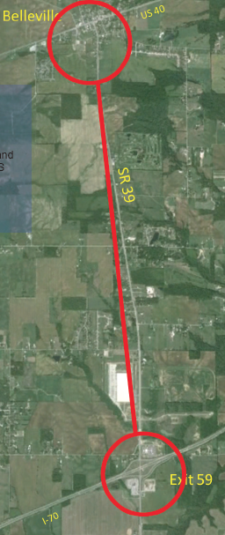
Planning Area
5.25 mile corridor along SR 39
Belleville at US 40 to Exit 59 on I-70

Slide 3
Why is this plan needed?
2006 Comprehensive Plan Recommendation for Interchange
Increasingly seen as “gateway” to Hendricks County
Development pressure will only increase
BEING PROACTIVE!

Slide 4
Plan Scope
  Non-residential development recommendations for the Exit 59 area
  General residential and non-residential development recommendations for the Belleville/US 40 corridor
  Streetscape and design recommendations for SR 39 between Belleville and Exit 59

Slide 5
How did steering committee develop this plan?
Public input (steering committee, public survey, etc.)
Expert economic development and planning input
Detailed research
Build on previous Hendricks County policies

Slide 6
Planning Process Status
  Plan Commission -- Public Hearing & Recommendation to County Commissioners
  County Commissioners – Consider adoption as part of Comprehensive Plan

Slide 7


Hendricks County
SR 39 Gateway Corridor Plan
Consultants: Partners:
Hendricks County Economic Development Partnership
County Sewer Board/TIF District
INDOT
Indianapolis MPO
Morgan County

Slide 8
STEERING COMMITTEE -- 8 open meetings
Steering Committee Members:
John Ayers, Hendricks County Engineer
Jim Diagostino, Superintendent, Mill Creek Community School Corporation
Peter Flynn, Morgan County Representative
John Hall, Developer and Property Owner
Cinda Kelley, Former Executive Director, HC Economic Development Partnership
Paul Kite, Developer and Property Owner
Paul Miner, Hendricks County Resident
Robert Montgomery, Technical Services Director, INDOT Crawfordsville District
Ron Myers, Liberty Township Trustee
Jeff Pipkin Interim Executive Director, HC Economic Development Partnership
Angie Tilton, Purdue Extension Educator
Brad Whicker, Hendricks County Plan Commission President
Special Thanks: Interested Residents:
Jeff Banning, Banning Engineering Steve Blunk
Andy Kult, Comer Law Office Bob Christian
Jerry Vornholt, Vornholt & Associates John Ditmer
Karl Kehrein
Ramona Leopard
Hendricks County Department of Planning & Building Planning Staff:
Don F. Reitz, AICP, Director Nicholas Hufford
Lesa Ternet Dan Walker, AICP
Owen Young

Slide 9
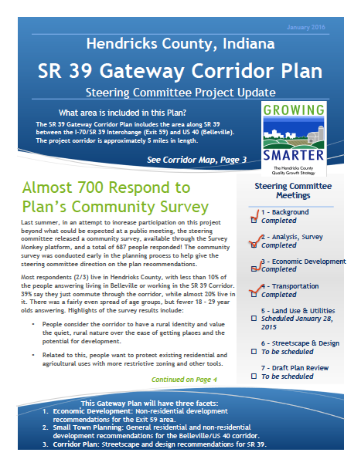
Public Updates
COUNTY WEBSITE
NEWSLETTER

Slide 10
Public Input
ONLINE COMMUNITY INPUT -- Survey Monkey survey on County’s website – almost 700 responses.
DRAFT PLAN OPEN HOUSE -- for public comment. Draft plan on County’s website, printed copies in all County’s libraries. Approximately 60 attendees voiced opposition to additional development. Response:
  Steering Committee met again and affirmed plan, with revision to reflect no-growth viewpoint, documented by survey answers
  Revised Draft Plan on website and available in all Hendricks County libraries and APC
  Plan Commission informational meeting in August

Slide 11
Community Survey Results
There were almost 700 responses to public survey
Still our best gauge of overall public response
Revised draft includes resident responses by area
  -- Responses were self-selected
  -- Could pick >1 area (i.e., both live in Belleville and live in Hendricks County)

Slide 12
Community Survey Results
Q2: Please select the answers that best describe you:
Answer Choices– | Responses–
–I live in Belleville | 9.17% 63
–I live in Hendricks County | 68.56% 471
–I live outside Hendricks County | 9.17% 63
–I live near the SR 39 Corridor, between I-70 and US 40 | 31.73% 218
–I work near the SR 39 Corridor, between I-70 and US 40 | 8.73% 60
–I am a frequent visitor, but do not live or work in the corridor | 11.79% 81
–I am an occasional visitor to the SR 39 Corridor | 22.71% 156
–I drive through the SR 39 Corridor as I commute | 18.20% 125
Total Respondents: 687

Slide 13
Background
DRAFT SR 39 Gateway Corridor Plan
Start every plan by analyzing what you have to work with

Slide 14
Background Economic & Demographic Data
Hendricks County Population Growth
7.3% gain from 2010 to 2014 (3rd fastest in state)
Continued growth is predicted for Hendricks County
  2nd highest in state for domestic migration
  8th highest international migration
  8th highest birth rate

Slide 15
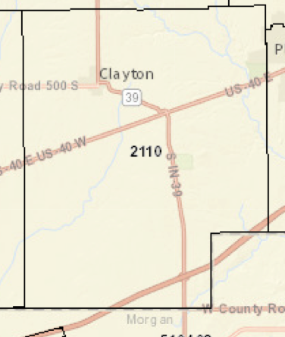
Background Economic & Demographic Data
Census Tract 2110 (Year 2010)
Population = 5772
Housing Units = 2254
Households = 2173
Average Wage = $63,018 ($15,000 higher than Indiana average)
High School Diploma or Higher = 90.3%
Bachelor’s Degree or Higher = 25%
Poverty Rate = 8.5% (5% less than Indiana average)
Average Age = 41.5 years (5 years higher than Indiana average)
100% of the population has Broadband Access

Slide 16
Resources (see Appendix B of Plan for full list)
Hendricks County Comprehensive Plan, 2006
Hendricks County Zoning Ordinance & Zoning Maps, 2008
Hendricks County Zoning Maps
Hendricks County Subdivision Ordinance, 2004
Hendricks County, Indiana Historic Sites and Structures Inventory, 1989
Plainfield Comprehensive Plan, 2016
Plainfield’s Sewer Master Plan
Morgan County Comprehensive Plan, 2010
Ronald Reagan Corridor Master Plan, 2003
Indiana State Trails, Greenways and Bikeways Plan, 2015
Indiana’s Manual On Uniform Traffic Control Devices, 2011
INDOT Common Paths Initiatives
CONEXUS Report (INDOT), 2015
Governor’s Blue Ribbon Panel on Transportation Infrastructure Report, 2014
LINK Hendricks County
Central Indiana Regional Transportation Authority (CIRTA)
Guide for the Development of Bicycle Facilities, AASHTO, 2012
NACTO Urban Bikeways Design Guide, 2013
Active Transportation Alliance
National Complete Streets Coalition
League of American Bicyclists
Bicycle Indiana
IndyCOG
Central Indiana Bicycling Association
Indiana State Dept. of Health, Div. of Nutrition and Physical Activity

Slide 18
2006 County Comprehensive Plan

Slide 19
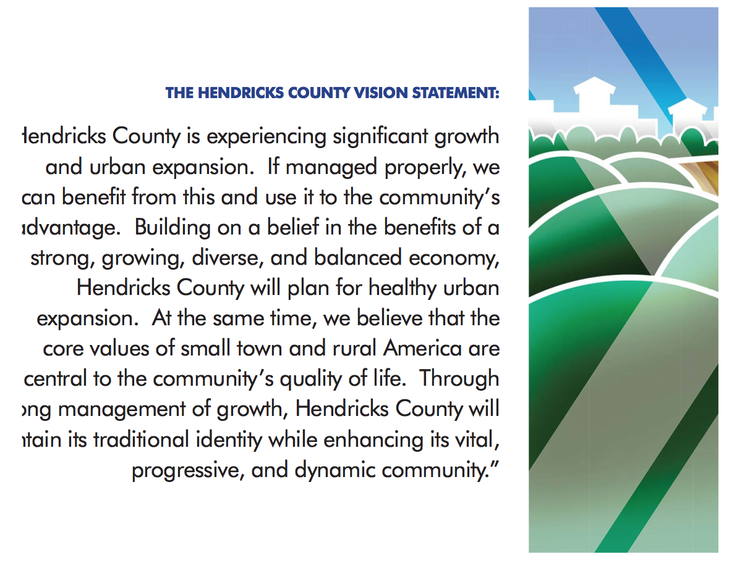
County’s Vision for the Future
The Steering Committee accepted the Hendricks County Comp Plan’s vision statement as appropriate for this plan also
THE HENDRICKS COUNTY VISION STATEMENT:
Hendricks County is experiencing significant growth and urban expansion. If managed properly, we can benefit from this and use it to the community’s advantage. Building on a belief in the benefits of a strong, growing, diverse and balanced economy, Hendricks County will plan for healthy urban expansion. At the same time, we believe that the core values of small town and rural America are central to the community’s quality of life, Through strong management of growth, Hendricks County will maintain its traditional identity while enhancing its vital, progressive, and dynamic community.”

Slide 20
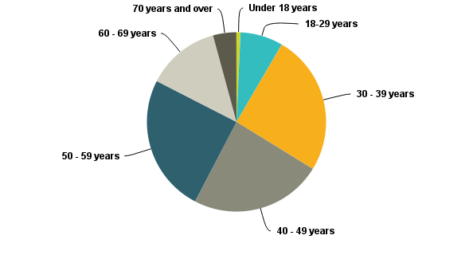
Community Survey Results
There were 687 responses
Q1: What age group do you belong to? A fairly even spread between 30 – 39, 40 – 49 and 50 – 59 year groups. Much fewer 18-29 year olds than expected.

Slide 21
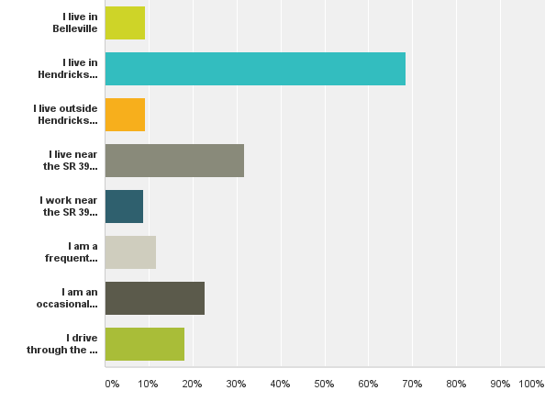
Community Survey Results
Q2: Please select the answers that best describe you:
Most respondents live in Hendricks County
<10% of those responding work in the SR 39 corridor area (60 people)
<10% of respondents were from Belleville (63 people)

Slide 22
Community Survey Results
Q5: What would encourage you to spend more time in the corridor?
ALL: >1/2 want more shops, stores and restaurants, almost 1/2 want a gathering place or park and >1/3 want safer travel options (including walk/bike connections)
LIVE IN CORRIDOR: (Almost the same response as all) about 1/2 want a gathering place or park, slightly less want more shops, store and restaurants, and >1/3 want safer travel options (including walk/bike connections)
WORK IN CORRIDOR: 60% want more shops & restaurants, 45% want gathering place/park and 37% want safer travel options (including walk/bike connections)
VISITORS: 62% want more shops & restaurants, 44% want gathering place/park
NO MORE GROWTH:
LIVE NEAR CORRIDOR – 33 people (15%)
IN BELLEVILLE – 10 people (6%)
LIVE IN HENDRICKS COUNTY – 25 people (5%)
“Nothing, we need to keep some areas rural”

Slide 23
Economic Development
DRAFT SR 39 Gateway Corridor Plan
Not all development is positive over time, so determine what type of development would best fit and have the greatest benefits for the County

Slide 24
Ball State Economist on State of ED
“We are selling a product... The community is the product. Therefore, we must constantly be in product development and…continuous improvement mode…Communities need to understand ‘where they are’ so they can develop grounded policies based on ‘where they can legitimately go’ to sustain economic self-sufficiency guided by quantitative research and in informed analysis.”
January 30, 2015, Michael J. Hicks, PhD, Director, Center for Business and Economic Research, Ball State University

Slide 25
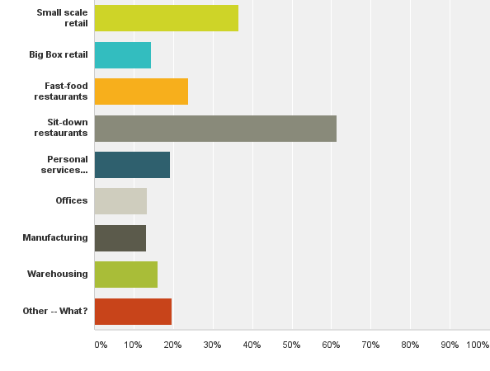
Community Survey Results
Q24: What types of businesses would you like to see more of in the corridor?
Sit-down restaurants and small scale retail were the top 2 answers for ALL, LIVES IN CORRIDOR AND WORKS IN CORRIDOR.
The majority of those responding “other” said no more business development:
LIVE IN BELLEVILLE = 14 people (30% of Belleville residents responding) LIVE NEAR CORRIDOR = 41 people (24% of Corridor residents responding) LIVE IN HENDRICKS CO = 46 people (14% of County residents responding)
“None, there are enough. West side of Hendricks County was not suppose to get developed. It's a farming community.”

Slide 26
Consultant’s SR 39 Findings by Area
Belleville
Potential for some residential development
New business development will mostly serve current residents
SR 39 corridor, south of Belleville to E CR 900 S
Limited development over the next 5 years (with exception of few areas being marketed for commercial and industrial development)
Interchange Area (corridor, between E CR 900 S & just south of I-70
great potential for future business development
Overall -- SR 39 corridor between Danville and I-70 will have greatest growth in greater Danville area and near interstate interchange

Slide 27
Consultant’s Findings
Zoning -- Hendricks County should continue to use its current Planned Business Zoning for new business development in a wide range of sectors such as transportation, manufacturing, service
Traffic -- Safety immediately north of the interstate on SR 39 a serious problem; ask INDOT to help fix
Speeding on 4-lane N of I-70
More signage or traffic signal to help semis find turn-offs
Business Sectors recommended for SR 39 & I-70:
Transportation
Manufacturing
Professional and Technical Services
Gateway -- Consider developing formal gateway into Danville and SW quadrant of county; explore working with Morgan County to develop SR 39/I-70 joint gateway

Slide 28
Basic Employer Targets
Business Cluster | Location Quotient versus U.S. for:
 | Industry Establishments | Employment | Annual Wages
Advanced Materials | 1.17 | 1.25 | 1.53
Biomedical/Biotechnical (Life Sciences) | 1.02 | 1.20 | 1.48
Business & Financial Services | 1.24 | 1.08 | 0.92
Chemicals & Chemical Based Products | 1.14 | 1.53 | 2.52
Defense & Security | 1.13 | 0.98 | 0.91
Information Technology & Telecom | 1.18 | 0.84 | 0.71
Transportation & Logistics | 1.32 | 1.75 | 1.57
Manufacturing Supercluster | 1.23 | 0.97 | 0.92
Fabricated Metal Product Mfg. | 1.32 | 1.27 | 1.25
Electronic Equipment, Appliance & Component Mfg. | 1.10 | 0.49 | 0.50
Transportation Equipment Mfg. | 1.28 | 1.27 | 1.48
Printing & Publishing | 1.27 | 1.09 | 0.85

Slide 29
Basic Employer Targets -- Manufacturing Supercluster
Primary Metals
Fabricated Metal Products
Machinery
Computer and Electronic Products
Electrical Equipment, Appliance and Components
Transportation Equipment

Slide 30
Basic Employer Targets –
Business & Financial Services
Includes Professional & Technical Services:
Legal
Accounting, Tax Preparation, Bookkeeping, and Payroll
Architectural, Engineering, and Related
Specialized Design
Computer Systems Design and Related Services
Management, Scientific, and Technical Consulting
Scientific Research and Development
Advertising and Related Services

Slide 31
Transportation
DRAFT SR 39 Gateway Corridor Plan
Much of what will drive the growth of the Corridor is transportation related, but the County does not control SR 39 or I-70, so it is crucial to coordinate with INDOT

Slide 32
INDOT Plans (may be unfunded, unscheduled)
Exit 59 Interchange -- Congested Exit 59 Interchange at I-70/SR 39 is to be rebuilt.
I-70 Dedicated Truck Lanes –Widen existing 4-lane rural segments to a minimum of 6 lanes from state line to state line. May happen in conjunction with Exit 59 Interchange work.
Indiana Commerce Connector – Construct an outer loop outside I-465, and though the route would not be within the plan area, it would impact it.
I-70/I-74 Connector – Connect the two interstates near SR 39 with an Interstate Grade Road.
US Bicycle Route 50 -- Part of a national “bicycle highway” system that will follow US 40 west through Belleville.
West Danville Truck Corridor –Build a new road from SR 39 at CR 200 W to SR 39 at N CR 200 W to S SR 39 at W CR 200 S.

Slide 33
Survey Results -- Transportation
Traffic safety and pedestrian/bicycle accommodations were top two transportation issues
>half agreed drivers speed
Biggest traffic concerns:
  Amount of semi-truck traffic (62%)
  High traffic (38%)
  No/inadequate shoulders along road (31%)

Slide 34
Community Survey Results
Q15 The current level of pedestrian accommodations on SR-39 (US 40 to I-70) is:
ALL: not adequate (65%)
LIVES IN CORRIDOR: not adequate (64%)
WORKS IN CORRIDOR: not adequate (66%)
VISITORS: not adequate (67%)
Q16 The current level of bicycle accommodations on SR-39 (US 40 to I-70) is:
ALL: not adequate (66%)
LIVES IN CORRIDOR: not adequate (66%)
WORKS IN CORRIDOR: not adequate (66%)
VISITORS: not adequate (69%)

Slide 35
Transportation Recommendations
Work with INDOT on accommodating bicycles and pedestrians in the corridor with a multi-use trail
Require a system of frontage roads or connected access drives along SR 39 with limited access and shared driveways
Work with INDOT to improve traffic safety in the corridor by implementing better signage and traffic calming provisions
Initiate regular communication with INDOT, Hoosier Rails-to-Trails, Central Indiana Bicycle Association and other stakeholders regarding US Bicycle Route 50
Coordinate with INDOT on the redesign and rebuilding of the Exit 59 Interchange
Continue to consider the State’s CONEXUS plans and coordinate locally if projects such as the Commerce Connector, the I-70/I-74 Connector and the Danville Bypass happen
Ensure that future improvements to SR 39 consider bus accommodations
Regularly evaluate and update the Thoroughfare Plan

Slide 36
Land Use & Utilities
DRAFT SR 39 Gateway Corridor Plan
The Corridor contains 3 distinct areas: Belleville/US 40 on the north, the I-70/SR 39 Interchange on the south, and the central area in-between.

Slide 37
Utility Services
Electrical: Adequate
WiFi: Adequate
Cellular Service: Adequate
Water Service:
Plainfield at US 40/39 to Deer Creek Golf Course
CEG at SR 39/70 north to Deer Creek
Sewer Service:
Plainfield on the North end of corridor planning area
  Includes new interceptor sewer project along west fork of White Lick Creek to eliminate Belleville sewer plant and connection to Plainfield south treatment plant
Hendricks County Regional Sewer District around the I-70/SR 39 Interchange

Slide 38
Utility Recommendations
Bury utility lines within the corridor
Continue to notify and seek comments from utility companies about proposed development applications
Continue to require all new development to have public water/sewer

Slide 39
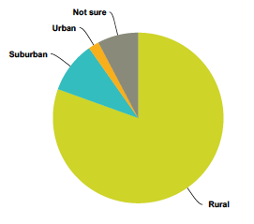
Land Use Character
The community survey asked what the identity of the SR 39 corridor is (Question 6), and the overwhelming response is Rural (80%).
Rural character is generally described as:
Farmland
Rolling topography
Trees along fence rows
Street Trees
Hilly roads
Open views
Large residential lots
Low density subdivisions
Farm structures
Wetlands and small ponds
Low levels of light pollution
Homes on private wells and septic systems
Narrow roads

Slide 40
Community Survey – Land Use
Q8 What housing does the corridor need more of? New Housing Top Answers:
  Large single-family homes
  Small single-family homes
  More senior housing or no more housing (residents)
  Higher density apartments (workers)
Q9 Should existing AG and single-family land uses be protected?
  >3/4 said protect existing agricultural and single-family
  60% support restrictive zoning to protect, with no-build easements, screening and large setbacks as other alternatives

Slide 41
Community Survey Results
Q12 What land uses do you think are appropriate in the corridor planning area? (top answers in order of popularity)
In Belleville:
ALL: Single-Family (49% - 249 people), Restaurants (46% - 237 people), Church & School (33% - 169 people), Mixed-Use (33% - 167 people)
  PREFER NO MORE DEVELOPMENT in Belleville*:
  LIVE IN BELLEVILLE = 27 people
  LIVE NEAR CORRIDOR = 71 people
  LIVE IN HENDRICKS COUNTY = 90 people
  * Note: Counts are cumulative

Slide 42
Community Survey Results
Q12 What land uses do you think are appropriate in the corridor planning area? (top answers in order of popularity)
Along SR 39 between I-70 and US 40:
ALL: Single-Family (47% - 251 people), Mixed Use (37% - 195 people), Restaurants (29% - 152 people)
  PREFER NO MORE DEVELOPMENT between I-70 & US 40:
  LIVE IN BELLEVILLE = 26 people
  LIVE NEAR CORRIDOR = 89 people
  LIVE IN HENDRICKS COUNTY = 113 people
    * Note: Counts are cumulative

Slide 43
Community Survey Results
Q12 What land uses do you think are appropriate in the corridor planning area? (top answers in order of popularity)
At the I-70/SR 39 Interchange:
ALL: Restaurants (57% - 317 people), Light Industrial (34% - 189 people), Warehousing (33% - 184 people), Auto & Truck Servicing (29% - 163 people)
  PREFER NO MORE DEVELOPMENT at Interchange:
  LIVE IN BELLEVILLE = 25 people
  LIVE NEAR CORRIDOR = 70 people
  LIVE IN HENDRICKS COUNTY = 84 people
    * Note: Counts are cumulative

Slide 44
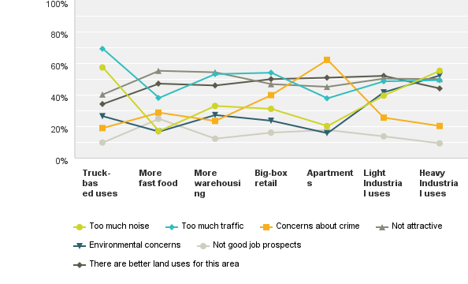
Community Survey Results
Q11: Are there some land uses that you do not want to see in the corridor and if so, why?
Highest concerns were about Truck-based uses due to traffic and noise
High concerns about crime with Apartments
More concerns with Heavy Industrial than Light Industrial (Noise, Environmental)
Answers for ALL and LIVE IN CORRIDOR were almost identical

Slide 45
Community Survey Results
Q24: What types of businesses would you like to see more of in the corridor?
Sit-down restaurants and small scale retail were the top 2 answers for ALL, LIVES IN CORRIDOR AND WORKS IN CORRIDOR.
The majority of those responding “other” said no more business development:
LIVE IN BELLEVILLE = 14 people (30%)
LIVE NEAR CORRIDOR = 41 people (24%)
LIVE IN HENDRICKS COUNTY = 46 people (14%)
“None, there are enough. West side of Hendricks County was not suppose to get developed. It's a farming community.”

Slide 46
Plainfield’s New Plan
Adopted March 28, 2016
State law prohibits Plainfield from exercising extra-territorial planning area, but they may include area outside current jurisdiction in comprehensive plan
the SR 39 Corridor is beyond the Tertiary Growth Area for Plainfield, meaning it is unlikely to be annexed anytime soon
Their future land use plan abuts the SR 39 planning corridor, extending west to S CR 400 E. Their plan shows Park and Open Space (shown in green) along the floodplain and recommends Single Family Detached (in yellow) north of E CR 750 S, with Light Industrial /Warehouse (in purple) south of E CR 750 S. Highway Commercial is also identified (in orange) around a potential interchange area at I-70 and CR 525
Potential interchange location reflects possibility that I-69 would go west of Mooresville and intersect I-70

Slide 47
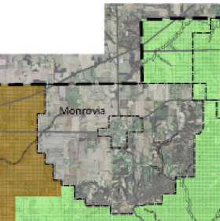
Morgan County’s Plan
Morgan County Future Land Use Plan
2010 Plan excludes SR 39 study area, Monrovia’s jurisdiction and planning area
Adjacent Future Land Use proposed Agricultural General (some housing) and Agricultural Preferred
SR 39 a Major Collector
Monrovia does not have a Comprehensive Plan, but local officials discussing need

Slide 48
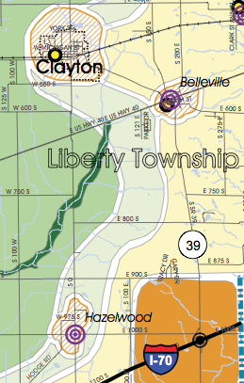
2006 Comprehensive Plan Recs
Belleville Area
Develop in a grid street pattern
  Infill development –Respect traditional / historic scale and pattern
  New development -- Pull up to street with sidewalks and landscaping as pedestrian buffers.
  Rehabilitation – Encourage rehabilitation of existing structures and residences
South to CR E 900 S
Conservation subdivisions appropriate with existing floodplains and conservation areas
Interchange Area
  Development should complement the surroundings
  Site layout should address access and connectivity with frontage roads, sidewalks and trails
  Architectural style, lighting, landscaping and other site amenities should provide unifying theme
  Parking limited to rear of buildings, and appropriately screened with landscaping

Slide 49
Corridor Planning Area
North End – Belleville/US 40
North End -- Community Survey
Half said no more development in Belleville, while 1/3 said Single-Family, Church and/or School
North End – Zoning: County Zoning Ordinance includes Town Center “floating” overlay zoning district
North End -- Compatibility: Infill development and redevelopment should look similar to what is around it. Compatibility typically includes height, proportion and setbacks, and may sometimes be extended to include building materials and architectural style.
North End – Consultant Findings
Belleville has potential for some residential development. New business development will mostly serve current residents. This area is best suited for residential and commercial redevelopment and Infill.

Slide 50
North Corridor Planning Area
Future Land Use Recommendation
Mix of small-scale commercial and residential uses
Belleville -- Infill and redevelopment within Belleville.
US 40 -- New small-scale commercial (no big box or strip commercial) in future if demand increases.
South of Belleville -- Develop in traditional grid pattern
East Side of SR 39 -- Between Belleville and golf course, single-family “New Urbanism” style development
West side of SR 39 -- Mixed-use development, including townhouses and low-density apartments
School – Possible new elementary school in the area (part of the Mill Creek School Corporation), which would be appropriate on either side of SR 39
PUD -- High-quality business or mixed-use campus development would be appropriate directly across from the golf course

Slide 51
Corridor Planning Area
Central Area -
Central Area -- Community Survey
Answers differed greatly depending on who was responding:
Residents - no more development (48%), Single-Family Residential (41%) and Mixed-Use Development (26%)
Workers - Single-Family (57%), Mixed Use (42%), Churches, Restaurants (33%)
Overall - Single-Family (47%), Mixed Use (37%) and Restaurants (29%)
Central Area –Agricultural Zoning
Central Area – Consultant Findings
Limited development next 5 years
Overall, less development than Interchange or Belleville
Central Area –- Future Land Use Recommendation:
Continue Agricultural uses, excluding confined feeding
Some mixed use, commercial or light industrial uses as a high-quality PUDs
Conservation subdivisions preferred over traditional single-family subdivisions

Slide 52
Central Corridor Planning Area
Future Land Use Recommendation
Continue Agricultural uses, excluding confined feeding
Some mixed use, commercial or light industrial uses as high-quality PUDs
Conservation subdivisions preferred over traditional single-family subdivisions

Slide 53
Corridor Planning Area
South End – Interchange Area
South End -- Community Survey
RESIDENTS: Restaurants (48%), No more development (36%), Warehousing and Light Industrial (27%), Office (24%)
WORKERS: Restaurants (62%), Warehousing (44%), Light Industrial (37%)
VISITORS: Restaurants (74%), Light Industrial (43%)
OVERALL: Restaurants (57%), Light Industrial (34%), Warehousing (33%), Auto & Truck Servicing (29%)
South End -- Zoning
PB, Planned Business (preferred zoning district)
Highway Business
General Business
South End – Consultant Findings
Between E CR 900 S and just south of I-70 has great potential for future business development. Business Sectors recommended for the SR 39 & I-70 interchange include: Transportation, Manufacturing, Professional and Technical Services

Slide 54
South Corridor Planning Area
Future Land Use Recommendations
Highest and best use Industrial or Office Development as part of a business park or campus setting, with some commercial support.
As gateway, not appropriate for big-box or strip retail, outside storage or undesirable uses (junkyards, sexually oriented businesses, etc.)

Slide 55
DRAFT Future Land Use Plan

Slide 56
Design Standards
DRAFT SR 39 Gateway Corridor Plan
Appearance and function are both equally important.

Slide 57
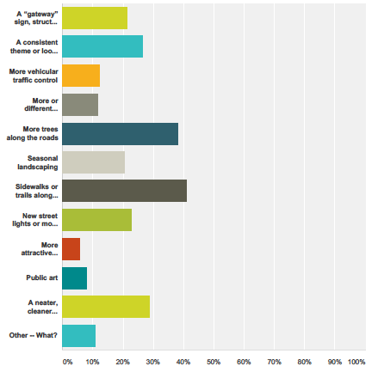
Streetscape/Design Survey Results
The community survey asked what would make the corridor more appealing?
#1 - sidewalks or trails along SR 39
#2 - more trees
#3 - neater and cleaner appearance
#4 - a consistent look

Slide 58
Community Survey Results
Q13 What would make the corridor more appealing?
ALL: 41% said sidewalks or trails along SR 39, 38% said more trees
LIVES IN CORRIDOR: 42% said sidewalks or trails, 38% said more trees, 27% said neater and cleaner appearance
WORKS IN CORRIDOR: 44% said sidewalks or trails along SR 39, 33% said neater and cleaner appearance, 28% said more trees
VISITORS: 37% said more trees, 36% said a consistent look, sidewalks/trails and a neater/cleaner appearance

Slide 59
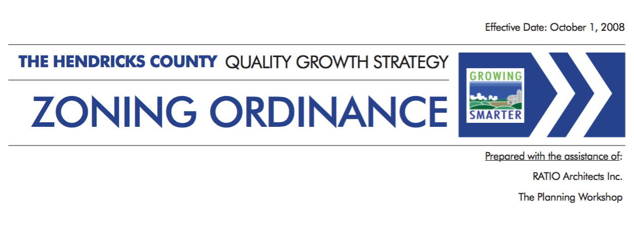
Development Standards
Standards for Development on Private Property
  Typically Contained in Zoning (and Subdivision) Ordinance
  Includes things like:
    Landscaping
    Signage
    Architectural Standards
    Parking
    Lighting
    Setbacks
    Height
    Etc.

Slide 60
Streetscape Standards
Standards for Development on Public Property (i.e., typically within the Right-of-Way); AKA Transportation Enhancements
  Usually in Handbook or Manual as guidelines, not an ordinance
  Includes things like:
    Landscaping
    Sidewalk/Trail
    Signage (i.e., way-finding signs, etc.)
    Lighting
    Street “Furniture” – Benches, Trash Receptacles
    Etc.

Slide 61
Consultant’s Recommendations
Looking Good Does Matter!
Low profile signage and attractive facilities help provide an appropriate welcome to the county from the Interchange
Develop formal gateways through signage and sculpture to help brand the County
  2 Gateways on Corridor
    Formal gateway into Danville
    SR 39/I-70 joint gateway with Morgan County

Slide 62
Streetscape Standard Recommendations
Major Intersection/Interchange Enhancements
Differentiate Crosswalks with pavement changes or high visibility markings
Include Pedestrian Signals
Consider Accent Plantings
Wayfinding Signs
Wayfinding signs not practical unless they are scaled for pedestrians
Driver confusion better addressed by large traffic control signs/street signs
Street Furniture
Adopt standards for: Benches, Water Fountains, Trash Receptacles
Bus Stops
Lighting
No ornamental lights, but include pedestrian scale lighting.
Explore a 2-level street/pedestrian light standard
Consider using solar lighting where appropriate
Landscaping
Require street tree plantings
Seasonal landscaping not a priority – possible adopt a gateway?
Encourage native species, with no mono-cultures, cluster informal plantings
Screen to block undesirable views

Slide 63
Streetscape – Landscaping & Lighting
  Landscaping and lighting represent the simplest and most cost effective means of providing a unifying element for the corridor
Landscaping & Lighting Example

Slide 64
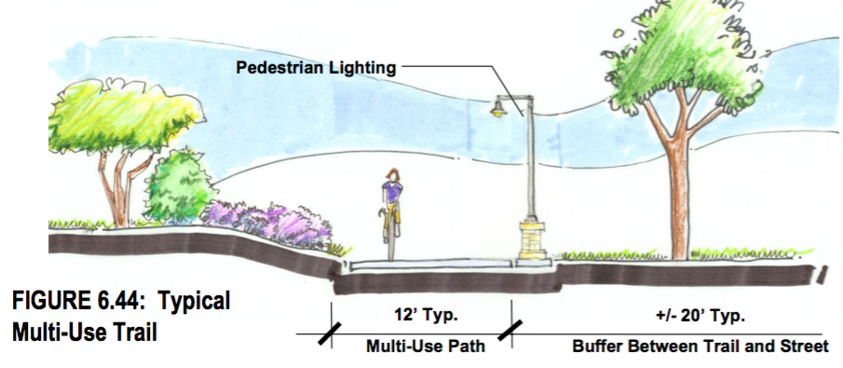
Streetscape –
Pedestrian/Bicycle Accommodations
  Ronald Reagan Overlay District = 12’ on 1-side of road

Slide 65
Action Plan – Highest Priority, 1–3 Yrs
Task | Document | Responsibility
Add Non-Residential Design Standards for Industrial/Warehouse Buildings | Zoning Ordinance | Plan Commission
Consider adding Conservation Subdivision standards | Subdivision Control Ordinance Update | Plan Commission
Add cross-access requirements for commercial and industrial development | Zoning Ordinance, Subdivision Control Ordinance Update | Plan Commission
Consider adding Traffic Calming standards | Subdivision Control Ordinance Update | County Engineer, Plan Commission
Update all sidewalk, bicycle and pedestrian trails and bicycle facilities, including bike lanes | Subdivision Control Ordinance Update | County Engineer, Plan Commission
Coordination with Other Governments & Organizations | n/a | Plan Commission Staff
Add Bicycle Parking Standard | Zoning Ordinance | Planning Staff, Plan Commission
Create an Advanced Plan Commission Website | Web Site | Planning Staff

Slide 66
Action Plan – Medium Priority, 4-6 Yrs
Task | Document | Responsibility
Design Trail along SR 39 | Trail Design & Specs | County Engineer, INDOT
Form Redevelopment Commission | County Ordinance | County Commissioners
Belleville Redevelopment – University Class Project | Redevelopment Plan | Planning Staff, Redevelopment Commission
Add Additional Minimum Regulations to Planned Unit Development District | Zoning Ordinance Update | Plan Commission
Develop a County Brand | Comprehensive Plan Update | Planning Staff & Hendricks Co Economic Development Partnership
Add Conservation Zoning District | Zoning Ordinance Update | Plan Commission

Slide 67
Action Plan – Low Priority, 7-10 Yrs
Task | Document | Responsibility
Construct Trail along SR 39 | Construction Documents | County Engineer, INDOT
Coordinate US Bicycle Route Development | N/A | County Engineer, Hendricks Co Economic Development Partnership
Set up Revolving Loan Fund for County | County Ordinance | Redevelopment Commission, Hendricks Co Economic Development Partnership

Slide 68
Action Plan – Ongoing
Task | Document | Responsibility
Tax Increment Financing Districts | TIF Plan | County Commissioners
Annual Comp Plan/SR 39 Review | Comprehensive Plan, SR 39 Gateway Corridor Plan | Plan Commission
Coordination with Other Governments & Organizations | SR 39 Gateway Corridor Plan | Planning Staff
Market corridor to businesses, to area employees (for housing), etc. | Marketing Materials | HCEDP
Economic Development Incentives | Marketing Materials | HCEDP, County Commissioners
Regional Economic Development Meetings | N/A | HCEDP
Work with Small Business | N/A | HCEDP

Slide 69
Plan Commission –
Comments or Questions?

